Slide 1
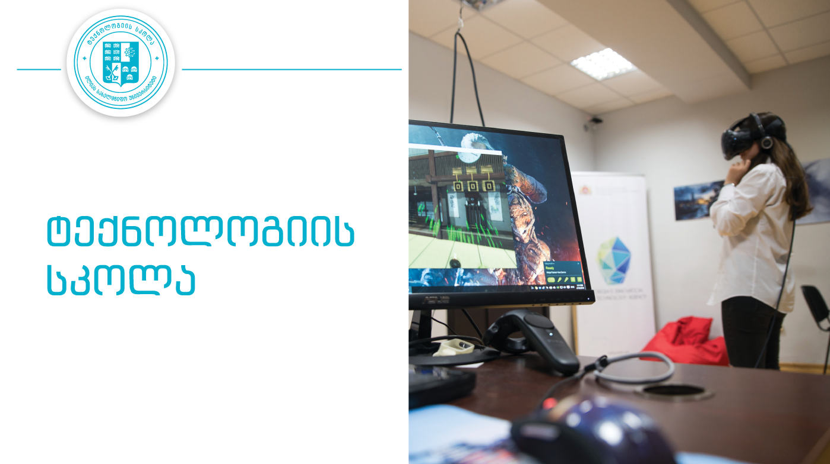
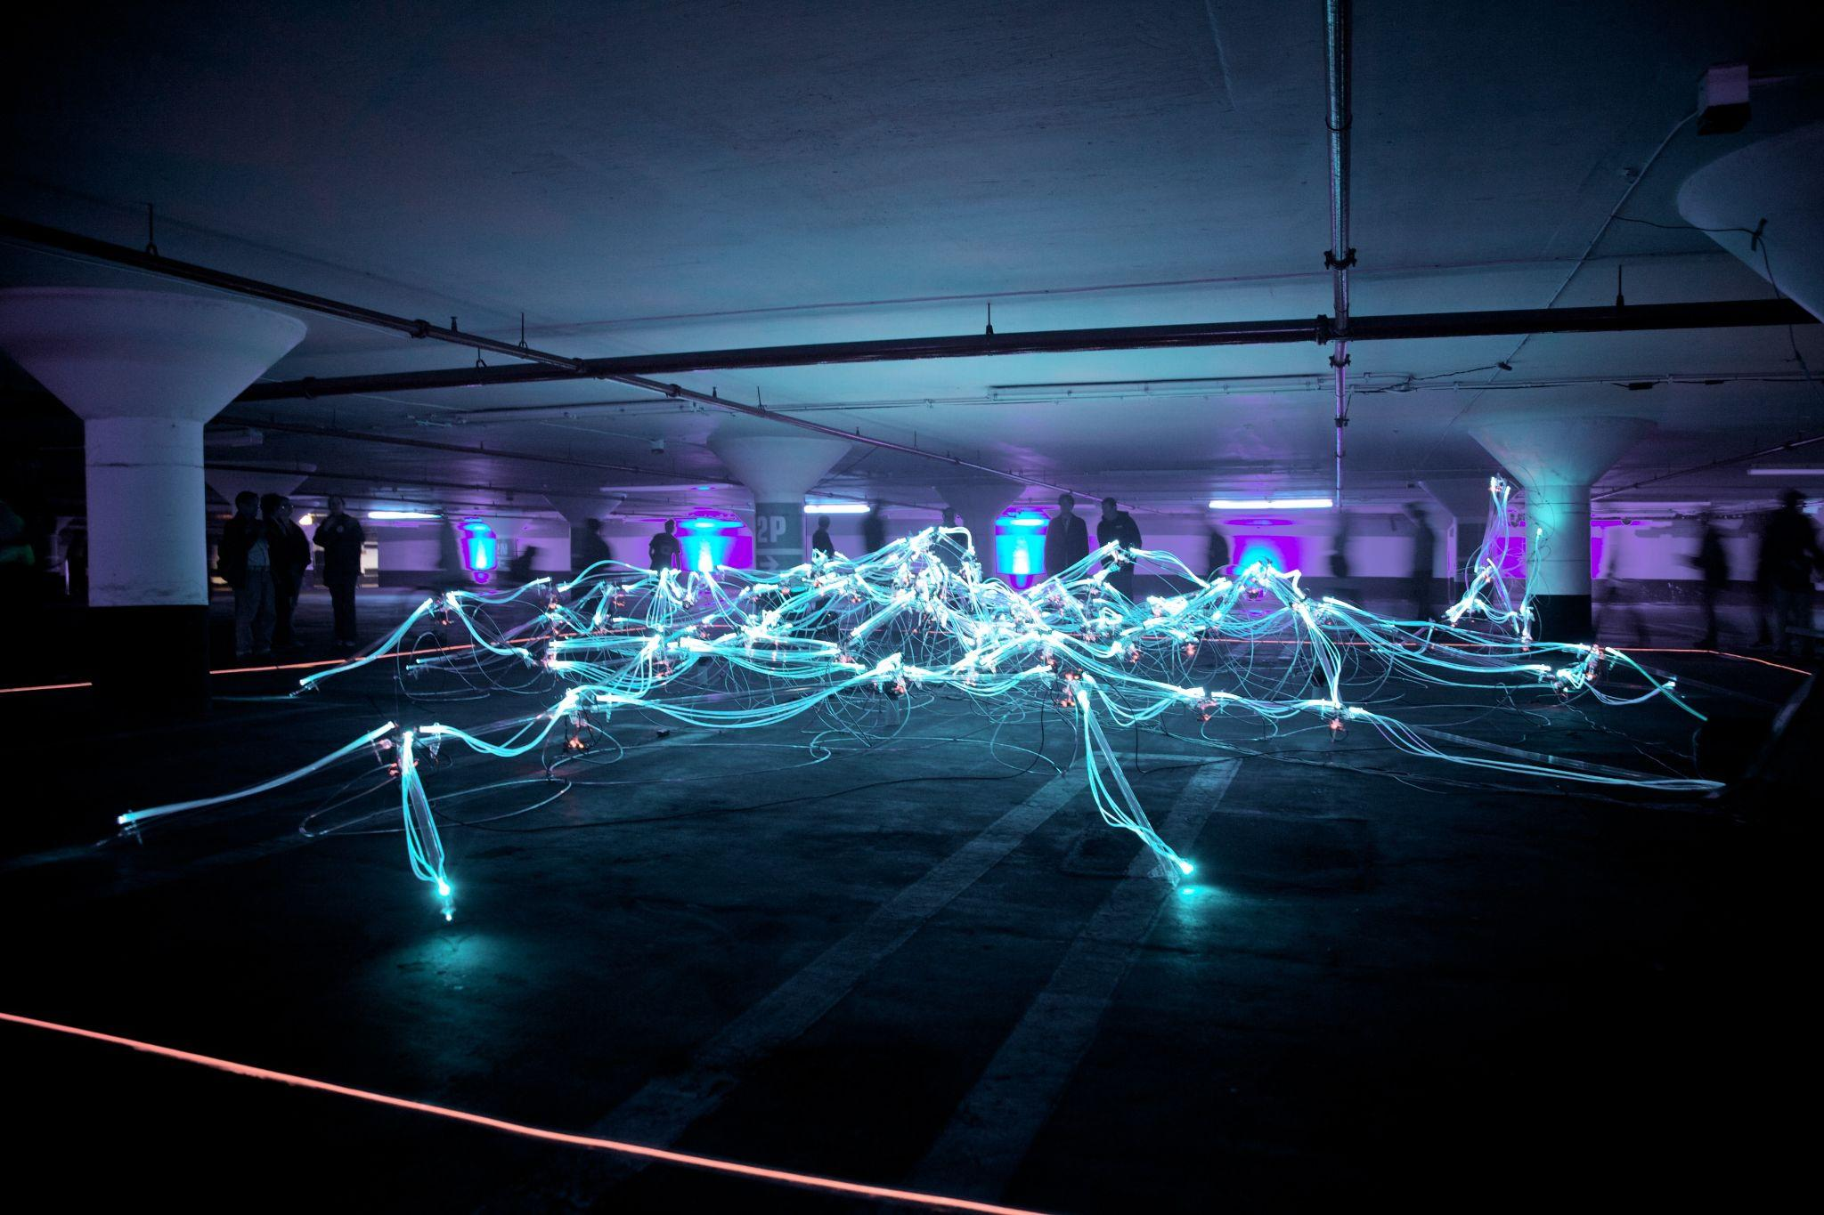
School of Technology
Guidelines for freshman

Slide 2
Essential Terms at the University
What is the University?

Slide 3





Structure of the University
Faculty of Arts and Science
Faculty of Business, Technology, and Education (BTE)
Faculty of Natural Sciences and Medicine
Faculty of Law
Central administration and Many Units of the University

Slide 4

Essential Terms at the University
What is the University?
What is the Faculty?

Slide 5




Structure of the BTE
School of Technology
BTE Administration of BTE
Dean of BTE
School of Business
School of Education

Slide 6
Essential Terms at the University
What is the University?
What is the Faculty?
What is the School?

Slide 7
Structure of the School of Technology
Director of the School
Program Coordinators
Administration of the School
Curriculum Experts
Departments
Mathematics
Computer Science
Digital Engineering
Civil Engineering
Architecture and Sustainable Development

Slide 8
Essential Terms at the University
What is the University?
What is the Faculty?
What is the School?
What is the Educational Program?

Slide 9
Programs at the School of Technology
Undergraduate Programs | Architecture (GEO)
 | Mathematics (GEO)
 | Computer Engineering (ENG)
 | Computer Engineering (GEO)
 | Electrical Engineering (ENG)
 | Computer Science (ENG)
 | Civil Engineering (ENG)
 | Civil Engineering (GEO)
 | Civil Engineering (ENG) SDSU
Graduate Master’s Programs | Modern Architecture and Sustainable Development (GEO)
 | Software Engineering (GEO)
 | Modern Paradigms and Application of Modern Mathematics (GEO)
Graduate PhD Programs | Mathematics (GEO)

Slide 10
Essential Terms at the University
What is the University?
What is the Faculty?
What is the School?
What is the Educational Program?
What is the Program Curriculum and the Study Plan?

Slide 11
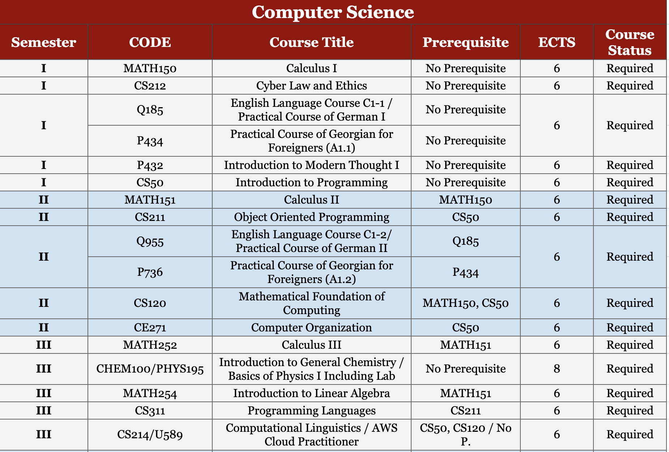
Example of Program Educational Plan

Slide 12
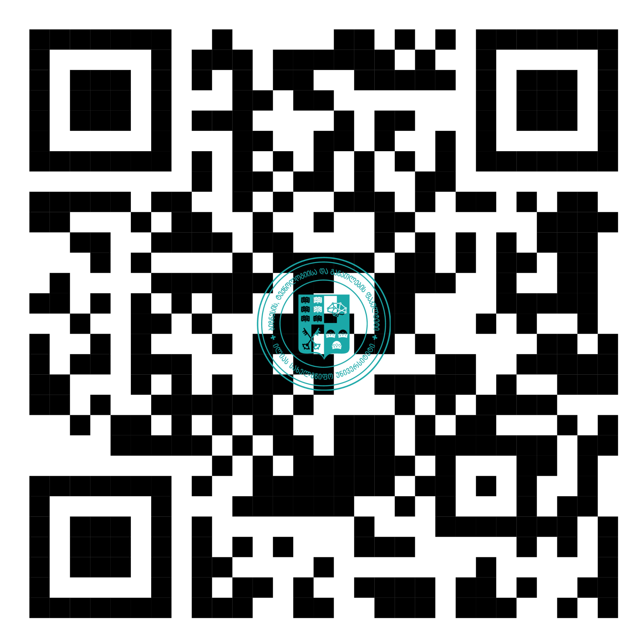
Catalogue of Courses
Computer Science
Computer Engineering

Slide 13
Essential Terms at the University
What is the University?
What is the Faculty?
What is the School?
What is the Educational Program?
What is the Program Curriculum and the Study Plan (major, general module etc.)?
What is the course syllabus?

Slide 14
Example of Course Syllabus
https://docs.google.com/document/d/1j0I0UjhICvUzcGMKT3XebI4hdWGdnZdEc9GRtX85jBQ/edit?usp=sharing

Slide 15
Essential Terms at the University
What is the University?
What is the Faculty?
What is the School?
What is the Educational Program?
What is the Program Curriculum and the Study Plan?
What is the course syllabus?
What is the Learning Management System ARGUS?

Slide 16
Argus
Choosing a subjects;
Information about your academic performance;
Courses, course syllabi, study materials, assignments;
Study schedules
Communication with lecturers;
Apply from Argus
Complaint Form Related to the Academic or an Administrative Process

Slide 17
Essential Terms at the University
What is the University?
What is the Faculty?
What is the School?
What is the Educational Program?
What is the Program Curriculum and the Study Plan?
What is the course syllabus?
What is the Learning Management System ARGUS?
What is elearning?

Slide 18
eLearning
https://elearning.iliauni.edu.ge/
Some instructors provide study materials and assignments in Argus and also in eLearning
You will be notified by the instructor about the usage of eLearning system in the beginning of the course
eLearning system is user friendly and helps you and the instructor to organize and manage the course
In addition google classroom can be used, which is used to your iliauni email account - classroom.google.com

Slide 19
Essential Terms at the University
What is the University?
What is the Faculty?
What is the School?
What is the Educational Program?
What is the Program Curriculum and the Study Plan?
What is the course syllabus?
What is the Learning Management System ARGUS?
What is elearning?

Slide 20
Apply from Argus
The letter/statement/e-mail is written in academic language;
The processing time for an application sent from Argus is 3-5 working days;

Slide 21

What i'm doing if I have a problem during the study course?
If the student has a problem with the lecturer/instructor, he addresses him in writing (the answer depends on the deadline set by the lecturer);
can apply to an ambassador who has experience in communicating with a lecturer;
the school administration considers the complaint within 3-4 working days; He will receive an answer in writing, by e-mail.

Slide 22
What is the syllabus?
The syllabus represents the program of the study course. in the syllabus Given:
teaching level;
Purpose and objectives;
teaching format (teaching method);
hour-by-hour content plan of the course with detailed reference to the pages of used textbooks or other resources;
principles of course evaluation;
Expected learning outcomes

Slide 23
Program-compatible credits
What is 1 ECTS equivalent to?
1 ECTS is equal to between 25 study hours;
The course catalog indicate how many credits a student must earn in which module in order to successfully complete the program and be awarded the appropriate qualification;

Slide 24
What is a prerequisite?
Prerequisite - a thing that is required as a prior condition for something else to happen or exist;
A prerequisite course is a course that must be successfully completed prior to being allowed to start on the next course.

Slide 25
Failing the course
It is possible to re-select the subject, however, the student should note that most of the core module courses are opened according to the semester study plan;
If the student fails the course 3 times, he/she lose the student status of the Ilia State University;
In case you will not be able to select the subject in ARGUS, because there is a limit on the accumulated number of credits. You should write an application to the Dean of the BTE Faculty with a request to add the subject (in this case, the student pays the fee for the additional study course/courses);
The total number of credits (ECTS) chosen by the student during the year (2 semesters) should not exceed 75 ECTS;

Slide 26
Midterm and Final Exams and their Recovery
Some midterm exams cannot be recovered due to the specifics of the study courses (for example, when the midterm exam is held in labs);
In some subjects, there may not be a midterm exam, students should consult with the subject instructor (preferably familiarizing themselves with the syllabus of the course at the beginning of the semester).
If you fail on final exam you can try one more time
You need to pay attention to the amount of accumulated points to be able to go to the final exam

Slide 27
Adding a semester
In the case that the student is unable to collect credits in their program’s major courses, even if you collect 75 credits per year, for obtaining the qualification (Bachelor’s Degree) you need to take additional semester;

Slide 28
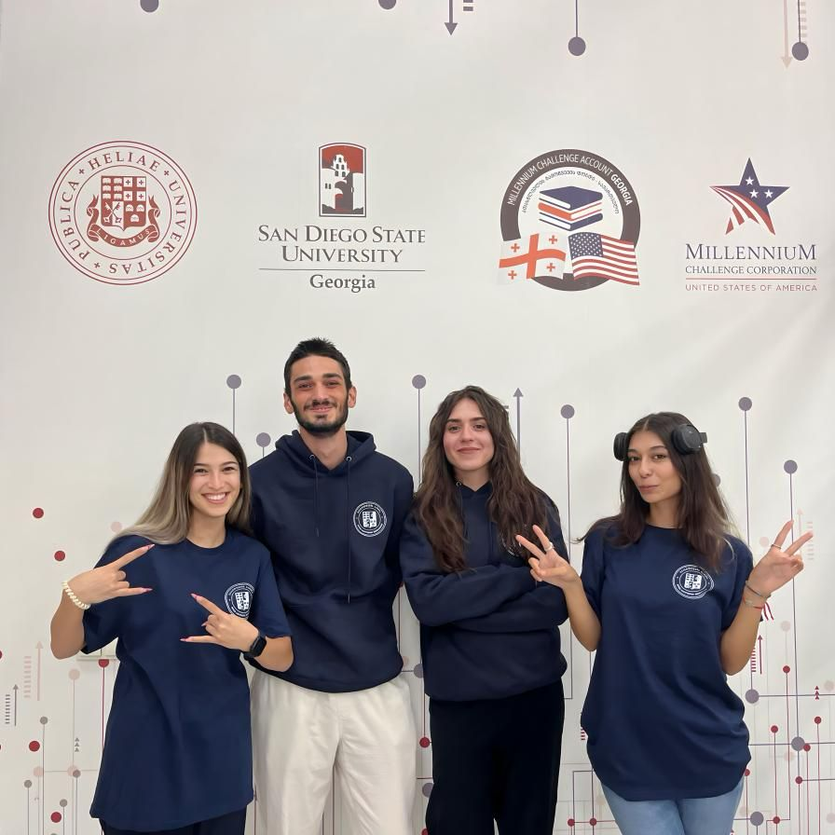
Student Ambassadors
Who are the Student Ambassadors?
How to become a student Ambassador?
Responsibilities;
Benefits;
FB Group of the Student Ambassadors:
https://www.facebook.com/groups/768487401954627

Slide 29
Employment opportunities
The employment promotion program - UNIJOBS;
The School of Technology cooperates with companies that offer students various jobs/internships;
Job fair

Slide 30
Key contacts?
Coordinators of School of Technology programs:
Gvantsa Lortkifanidze - architecture, mathematics
☏ 032 2 22 00 09 (138), ✉ gvantsa.lortkipanidze@iliauni.edu.ge, T207
Ana Tchrelashvili - computer science, computer engineering, electrical and electronic engineering
☏ 032 2 22 00 09 (276), ✉ ana.tchrelashvili@iliauni.edu.ge, T207
Ana Kvaratskhelia - civil engineering, ISU Services (Jobs/internships) ☏ 032 2 22 00 09 (358),
✉ ana.kvaratskhelia@iliauni.edu.ge, T207
Quality Assurance Specialists of the School of Technology programs:
Ani Tophuria- computer science, computer engineering, electrical and electronic engineering
☏ 032 2 22 00 09 (420) ✉ ana.tophuria@iliauni.edu.ge,, T207
Mariam Machavariani- architecture, mathematics, civil engineering
☏ 032 2 22 00 09 (319), ✉ mariam.machavariani.4@iliauni.edu.ge,, T207
Ana Kvaratskhelia- Mineral Resources And Energy Management And Sustainable Development
☏ 032 2 22 00 09 (358), ✉ ana.kvaratskhelia@iliauni.edu.ge, T207

Slide 31
More Contacts
Library- ✉ librarian@iliauni.edu.ge / library@iliauni.edu.ge
Department of Student Affairs - ✉ student.affairs@iliauni.edu.ge
Iliauni Events- ✉ tvitmartveloba@iliauni.edu.ge
Fab Lab Iliauni- ✉ fablab@iliauni.edu.ge
Events of the School of Technology- ✉ ana.kvaratskhelia@iliauni.edu.ge
Erasmus+ - ✉ foreign-relations@iliauni.edu.ge; ☏ 032 2 22 00 09 (367)
Financial issues ☏ 032 2 22 00 09 (182)
Argus- ✉ argus@iliauni.edu.ge

Slide 32
Administration of School of Technology
✉ techschool@iliauni.edu.ge
Building T, Room 207

Slide 33
Thank you for your attention!

